Slide 1
Inner Source @ Agoda
By Joel Dickson (Development Manager)
And Varokas Panusuwan

Slide 2
What is Inner Source
Open source method applied within an organization
InnerSource differs from classic open source by remaining within the view and control of a single organization. The “openness” of the project extends across many teams within the organization. This allows the organization to embed differentiating trade secrets into the code without fear that they will be revealed to outsiders, while benefitting from the creativity and diverse perspectives contributed by people throughout the organization.
O’Reilly – Getting Started with InnerSource
Source:

Slide 3
How did we work before?
Looking at a basic example of two teams
Website team, and API team

Slide 4
How did we work before?
Features would be technically split, most of the time by Product Owners
Creating dependencies between teams that was hard to manage

Slide 5
How did we work before?
Commonly know as Sprint+1
After sprint 1, API teams hands off work to WebSite team
Inevitable API team will not get the requirements 100% correct and WebSite team will interrupt them during Sprint 2 for changes

Slide 6
How did we work before?
Interruptions not only cost work but also context switching
25% drop because of this
The solution? “we need to do more planning”, and want to add 10% more in sprint 1
Waterfall anyone?
Self-containing this work into a single team/sprint is the best solution

Slide 7
What changed with InnerSource Approach
A feature requirement is given to Team Y that requires change to both website and API

Slide 8
What changed with InnerSource Approach
Team Y works on a fork and sends a pull request back to Team X when done
Team X has quality built into pull request system
Unit Test
Integration Tests
Code Review
Static Code Analysis
Allows for Features Teams, but maintains ownership

Slide 9
How the system helps you maintain ownership
Looking at the example from before. Team X becomes responsible for the technical ownership for the API. They drive the architecture and own this product.

Slide 10
Why is ownership important?
People care more about what they are working on
Proven to have a good effect on quality https://www.visualstudio.com/en-us/articles/devopsmsft/code-ownership-quality
Motivates people through sense of creation
Getting ownership right means teams owning things end to end (no fences to throw things over)

Slide 11
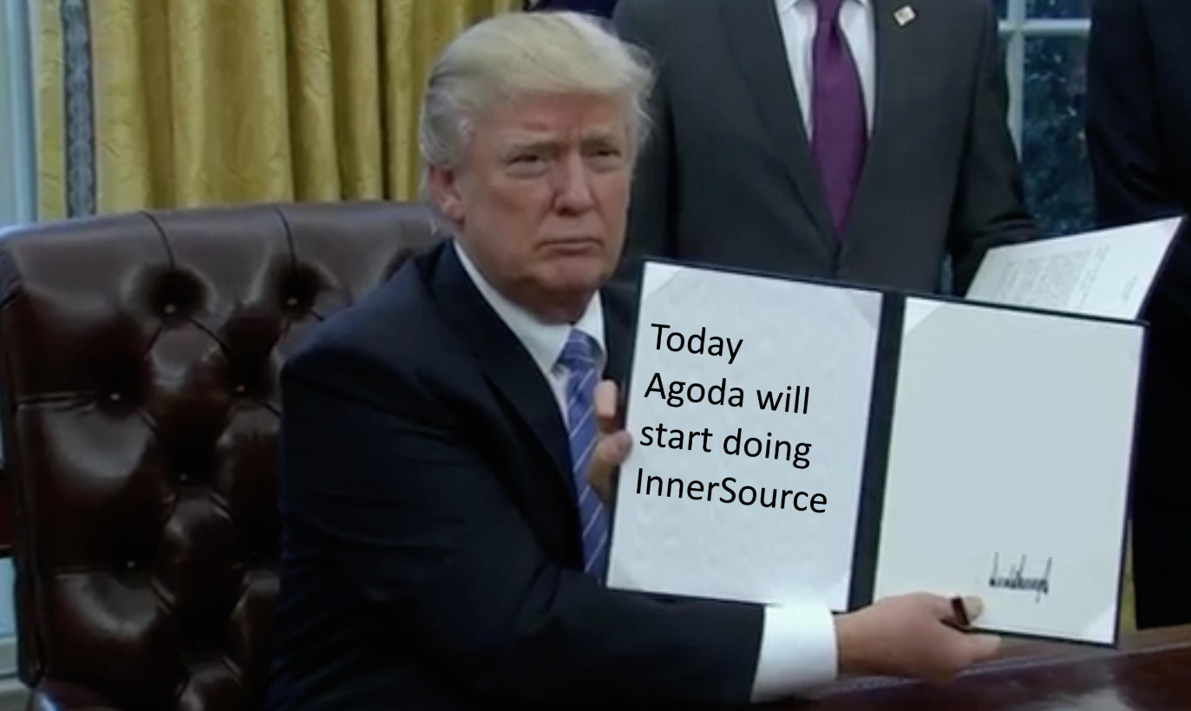
What did NOT happen at Agoda with the adoption of InnerSource
There was no executive order to start practicing InnerSource
We didn’t even know what InnerSource meant, and a lot of people still don’t

Slide 12

What did happen with the Adoption of InnerSource
We had an organic bottom up adoption
Most people still don’t know the term InnerSource it’s just “what we do” now
Teams looked at the processes around GitHub and the other tools we are using, some developers were already familiar and they just started using them
Some Teams we had to demo and suggest the processes around forking and pull requests, and they start using them
Some new staff came to the company with the attitude “Why aren’t we doing this already?”

Slide 13
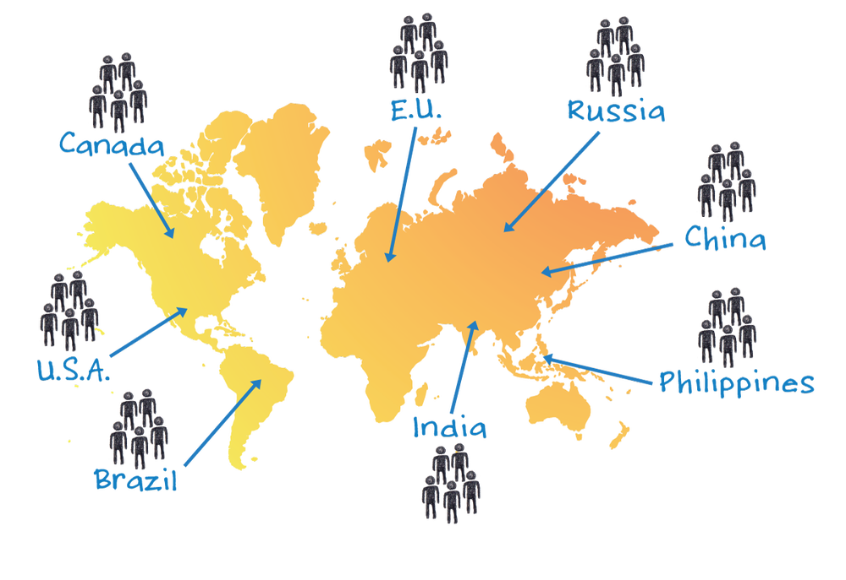
What things about inner source did NOT apply well?
Open source projects are generally distributed, at Agoda we are all co-located. This is part of our IT department structure that we are all co-located, and this solves a lot of issues for us. This also means we don’t need the benefit that a lot of the tools for OSS offer.

Slide 14
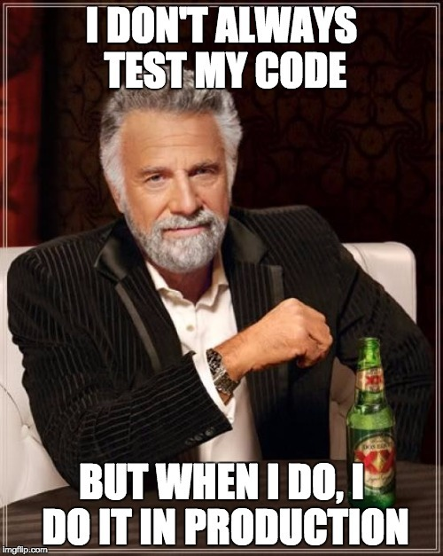
When did teams resist and what reasons did they give?
“You won’t be able to understand the logic in our system, its unique to our team, we are afraid you would break something” – Anonymous Developer at Agoda
Comments like this come from teams with very poor test coverage. One of the key points to making this work is good test coverage, and also other similar practices such as static code analysis, etc. more broadly know as “Technical Excellence”

Slide 15
Other Sharing internally?
Single open TeamCity server
Single Shared SonarQube Server
Single Shared Codecov Server
Using Language Agnostic tools where possible to allow sharing between teams
We have mobile Teams working on Swift, sharing things with front end teams working on C# dot NET
Open permissions up as much as possible, empowering people, making them owners of their own domain

Slide 16
Questions?

